Slide 1
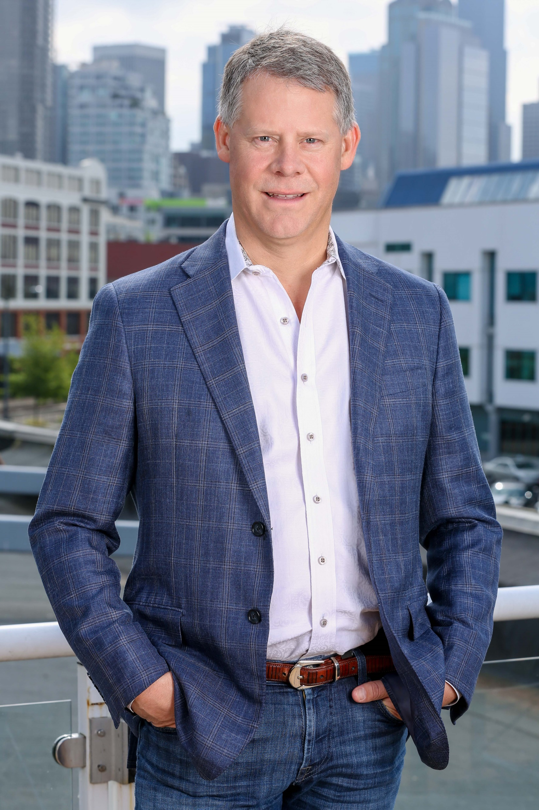
George Petrie Goodman Real Estate

Slide 2
Who is GRE
Privately held vertically integrated real estate investment, development and management company.
289 team members
14,000 units in 8 states
5,609 new units
5,146 renovated units
36,000 residents throughout the United States
Notes:
Both New and Renovated are from Eric for the last 10 years

Slide 3
What is Value?

Slide 4
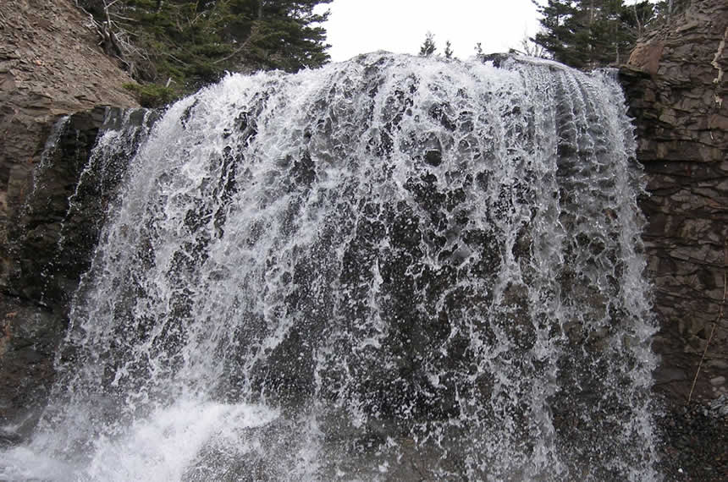
Value in the Moment
When will the statewide order expire?
What will the public perception be?
How our industry navigates the next 90 days is essential.
Notes:
August 2….30…. OR?

Slide 5
Value in the Moment
What are we doing now for our 8,000 Washington residents?
Issued a COVID-19 CARES Credit to 95% of residents - $324,000 (May & June)
Offered Partial Pays with over 584 residents utilizing this plan.
Implemented Payment Agreements with over 50 households and over 300 are in-progress.
Reversed Late Fees - $464,000 (March-current)
Waived MTM fees - $96,000 (March-current)
Revered all Rent Increases - $86,000 (March-current)
Deferred - $53,000 for future months.
Offering Community Resources through frequent resident communication.
What are we planning on doing?
We are brainstorming new programs such as hosting job fairs, evaluating job placement programs, credit counseling, roommate match, write off, lease extensions to prevent the wave.
Compassion & Accountability
Working with our residents to find and maintain shelter & advocating for the ban to be lifted with government rental assistance.

Slide 6
Value on the Horizon

Slide 7
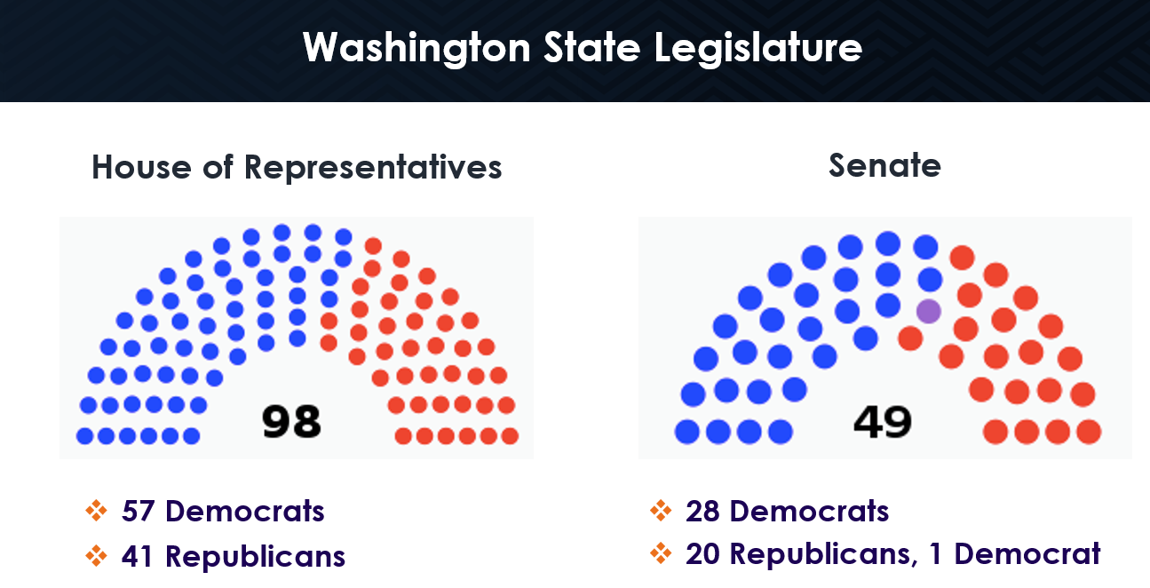
Value on the Horizon

Slide 8
Value for the Future
Regional supply demand imbalance - supply needs to be increased to 15,000 new units each year for the next decade.
Legal and political advocacy…. we include that emphasis in our operating agreements.
Legal and political contributions….we include budgeted line items in our annual budgets.

Slide 9
Value for the Future

Slide 10
In the Arena
Speech that Teddy Roosevelt gave in 1910…….
“It is not the critic who counts; not the man who points out how the strong man stumbles, or where the doer of deeds could have done them better. The credit belongs to the man who is actually in the arena, whose face is marred by dust and sweat and blood; who strives valiantly; who errs, who comes short again and again, because there is no effort without error and shortcoming; but who does actually strive to do the deeds; who knows great enthusiasms, the great devotions; who spends himself in a worthy cause; who at the best knows in the end the triumph of high achievement, and who at the worst, if he fails, at least fails while daring greatly.”

